Slide 1

2025 for 2026 Career Guidance Evening

Slide 2
Mission of Grantley College
DHET – NCV Level 2 – 4 culmination in NCV Senior Certificate
DBE - CAPS Grade 10 – 12 culminating in National Senior Certificate
To offer an NQF 4 qualification that leads to tertiary education.

Slide 3

Journey 1 – CAPS NSC
Grade 10 – 12 Culminating in NQF 4 National Senior Certificate:
Broad based education
Variety of subjects
3 possible qualification levels
Certificate pass – One-year higher certificate study
Diploma pass – Diploma 2 – 3 years or TVET course
Bachelor's pass – Degree
Note a Bachelors pass does not automatically guarantee entry to University.

Slide 4
NSC – Subject choices
Compulsory Subjects
English Home Language
Afrikaans First Additional Language
(No exemption from Afrikaans)
Life Orientation
Mathematics / Mathematical Literacy
Elective Subjects
Business Studies / Drama Studies
Computer Application Technology / Hospitality Studies
Design Studies / Tourism / Life Science

Slide 5

Mathematics
Grade 10 - 12
Patterns, Sequences and Series. Functions. Exponential and Logarithmic Functions. Finance, Growth and Decay. Trigonometry: Compound and Double Angle Identities. Trigonometry: Problem Solving in Two and Three Dimensions. Polynomials. Differential Calculus.
Must have 50% for core math exam in Gr 9
Linear curriculum
Fast paced
Requires extra hours daily
Abstract content

Slide 6
Mathematical Literacy
Grade 10 - 12
Numeracy Finance Measurement Maps, plans and other representations of the physical world Data handling Probability .
Cyclic curriculum
Real world mathematics
Applied mathematics

Slide 7

Business Studies
Grade 10 | Grade 11 | Grade 12
Entrepreneurship. Business opportunity and related factors. Business Plan. Management and Leadership. Forms of ownership. Setting up a business. Contracts. Business location. | Business Environments Business Operations Influences of business environments. Marketing function. Challenges of the business environment. Production function. Adapting to challenges of the business. Resources. Contemporary socio-economic issues. | Impact of recent legislation on business. Human Resources function. Professionalism and Ethics. Creative Thinking. Devise Strategies for a Business to Use in its Response to the Challenges of the Macro Business Environment.
Interest in Business
Theoretical subject
Good writing skills

Slide 8

Dramatic Arts
Grade 10 | Grade 11 | Grade 12
South African Theatre Greek Theatre Non verbal theatre Medieval Theatre Staging and Film Individual and Group Practical Productions | Realism in theatre Voice and body work South African Theatre Physical Theatre Stylized Theatre Direction and Design Poor Theatre Practical Productions | Theatre of the Absurd South African Theatre Post 1994 South African Theatre South African Contemporary Theatre Theme Programme Prep and Performance.
Art orientated
Confidence
Imagination
Curious
50/50 Theory and Prac
Written work

Slide 9

Computer Application Tech
Grade 10 | Grade 11 | Grade 12
Computer Management Software Hardware Networking Spreadsheets Word Processing Information Management HTML | Computer Management Software Hardware Networking Spreadsheets Word Processing Information Management HTML and web design Internet technologies Databases | Computer Management Software Hardware Networking Spreadsheets Word Processing Information Management HTML and web design Internet technologies Databases
Detailed
Application
Cyclic learning
Time consuming (practice)
Computer not cell phone
50/50 prac and theory

Slide 10

Hospitality Studies
Grade 10 | Grade 11 | Grade 12
Hygiene Restaurant and Kitchen operations Recipes Food Pyramids Moist heat and Dry heat cooking Fruits, meats, eggs pasta | Nutrition Menu Planning Table setting Yeasts Cakes and Biscuits Poultry, Fish, Sauces Stock and storekeeping Food contamination Career Pathways | Nutrition Menu Planning Preserved Food Desserts Gelatines Costing Food and Beverage Pastry and Meats
Real Life Application
Interest in food
Detail orientated
Work under pressure
50/50 prac and theory

Slide 11

Tourism
Grade 10 | Grade 11 | Grade 12
Tourism Sectors – Profiles Accommodation Food and Beverage Mapwork and Tour Planning Domestic Tourism Sustainable Tourism Marketing Careers | Tourism Sectors - Travel Domestic Growth Strategy Culture and Heritage Tourism Marketing in Tourism Tourist Attractions Marketing Customer care Foreign Exchange Careers | Global Events Mapwork and Tour Planning Travel Health Documentation World time zones World Tourist Icons Marketing Foreign Exchange Customer Care
Real Life Application
Cyclic learning
Learning Subject
Large sector application
Basic Business Subject
40/60 prac and theory

Slide 12

Design Studies
Grade 10 | Grade 11 | Grade 12
The design process Elements and principles of Design Techniques and Media Visual Design Environmental Design History of Design Greek - Baroque | Design Literacy Typography Political Propaganda Signs and Symbols Gestalt Theory History of Design – Arts and Crafts to Art Deco Modernism Scandinavian Design Sustainable Design | Pop Design Post Modernism Architecture – classic and contemporary Design in social context Design in cultural context Design in environmental and sustainable context Revision 10,11,12
Real Life Application
Attention to detail
Practical Art
Flexible and Creative
20-hour prac.
50/50 prac and theory

Slide 13

Life Science
Grade 10 | Grade 11 | Grade 12
Chemistry of Life Cells Cell division Plant tissues, organs, transport Animal tissues, organs, transport Biosphere to ecosystems | Biodiversity in micro-organisms, plants and animals Photosynthesis Cellular Respiration Animal Nutrition Gaseous Exchange Excretion in Humans Population Ecology Human impact on the environment | DNA Meiosis Reproduction in Vertebrates Reproduction in Humans Genetics Response to environment – humans and plants Evolution
Theoretical
Learning Subject
Detail orientated
Large Curriculum
Science Option

Slide 14
Journey 2 NCV College of Hospitality
Level 2 – 4 Culminating in an NQF 4 level Matric Equivalency
Industry sector relevant education
As per the identified critical skills and needs of the country
Only one level of qualification
Varying requirements for entry to university and further study as determined by the particular university.
Accepted for direct entry into the workplace.

Slide 15

NCV College of Hospitality Examinations and Assessments
Internal Continuing Assessment – ICASS 50/50 prac and theory
Internal Examinations
Internal Summative Assessment – ISAT (PAT)
External Examinations - Finals

Slide 16
NCV – College of Hospitality
Foundational
English First Additional Language - 40%
Life Skills – 40%
IT plus Cisco – 40%
Mathematics / Mathematical Literacy – 30%
** No second language
Sector Subjects
Client Services and Human Relations – 50 %
Hospitality Generics – 50 %
Hospitality Services – 50 %
Food Preparation – 50 %

Slide 17

College of Hospitality
Are you –
A foodie – enjoy the kitchen
Creative with a flair for making food look good
Enjoy people – or can just hide in the kitchen
Love travelling
Like making people feel welcome
Like making money
Perhaps have an SLD in language – not a fan of Shakespeare
Maths is like Greek
Willing to work really hard

Slide 18

Client Services and HR
Level 2 - 4
The comprehensive introduction to dealing with a client successfully whilst managing and nurturing staff. Personal professional development inc codes of conduct Client communication Client feedback and management thereof Verbal and nonverbal communication Business in a cultural context Legislation and CCMA Inclusion of colleagues and clients with special needs

Slide 19

Hospitality Services
Level 2 - 4
Overarching knowledge of all services required in the Hospitality Industry. Glassware – care, cleaning, selection Drinks and drinks machinery Beds, Linens and Coverings Bathrooms and Toilets – care, cleaning and stocking Floors and Floor covering – choices, durability, cleanliness Public areas – Occupational Health Communication Skills

Slide 20

Hospitality Generics
Level 2 - 4
Comprehensive knowledge of generic services within the Tourism and Hospitality sector. Tourism and Hospitality Sectors Careers opportunities within the sector Leadership, entrepreneurship, team management Professional Appearance and Communication Health Hygiene and cleaning protocols

Slide 21

Food Preparation
Level 2 - 4
Comprehensive knowledge of food preparation, menus and menu planning, nutrition and kitchen management. Hygiene and Cleanliness Kitchen Occupational Health and Safety Kitchen management – stock, storage and time management Kitchen equipment Preparation of all food types: meats, vegetables, starches Drinks – alcoholic and non-alcoholic

Slide 22

Journey 3 NCV College of Marketing and Design
Level 2 – 4 Culminating in an NQF 4 level Matric Equivalency
Industry sector relevant education
As per the identified critical skills and needs of the country
Only one level of qualification
Varying requirements for entry to University and further study as determined by the particular university
Accepted for direct entry into the workplace.

Slide 23
NCV – College of Marketing and Design
Foundational
English First Additional Language - 40%
Life Skills – 40%
IT plus Cisco – 40%
Mathematics / Mathematical Literacy – 30%
** No second language
Sector Subjects
Marketing – 50 %
Marketing Communication– 50 %
Advertising and Events– 50 %
Graphic Design– 50 %

Slide 24
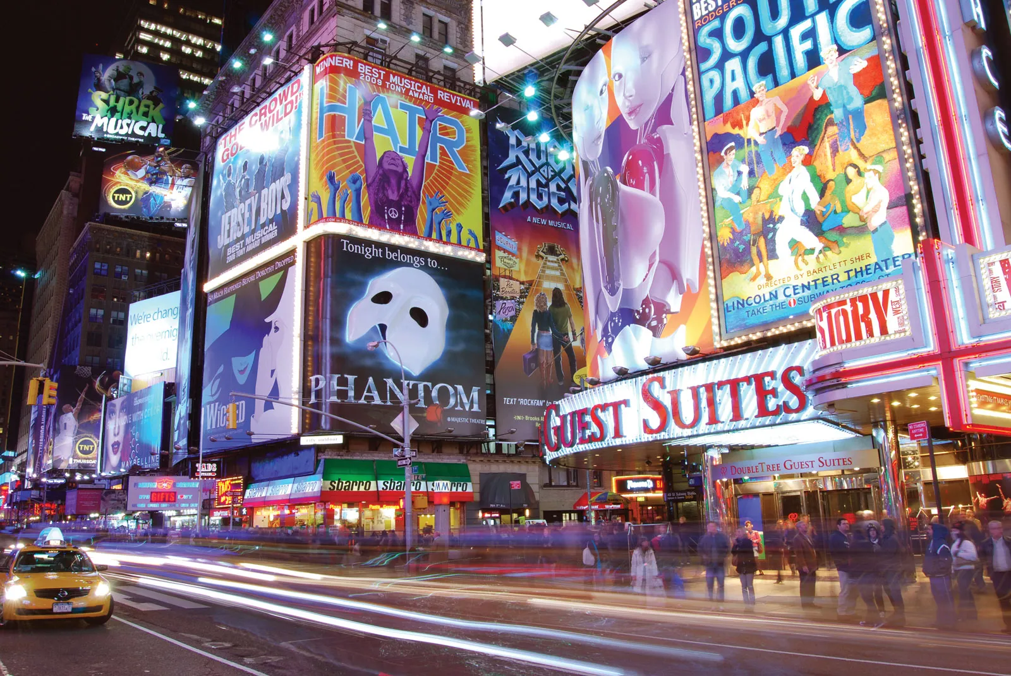
College of Marketing and Advertising
Are you –
Forever talking
Creative with a flair for art and design
Enjoy computers
Not shy with people
Like making money
Perhaps have an SLD in language – not a fan of Shakespeare
Maths is like Greek
Willing to work really hard

Slide 25

Marketing
Level 2 - 4
A comprehensive study of all forms of marketing including digital and social medial marketing Scope and Dynamics of Marketing The marketing policy The marketing plan The marketing mix The marketing environments Factors influencing organisational marketing Target markets and feedback

Slide 26

Marketing Communication
Level 2 - 4
A comprehensive study of verbal, non verbal, graphic and textual communication within the marketing arena The communication model The psychology of communication Brand communication Communication design Techniques in Communication In house communication Client Communication

Slide 27

Advertising and Events
Level 2 - 4
The study of the broad scope of advertising, events and promotions within the marketing space. Advertising principles Developing creative strategy The client and client interaction Promotional mix in marketing The promotional plan Mass Media Persuasive advertising Target Audiences Feedback cycles

Slide 28

Graphic Design
Level 2 - 4
The study of graphic design within the marketing scope for use of sales and advertising Design Theory Hand drawing and design Computer Aided graphic design Desktop publishing Digital design Layout / Typography Photography 3D design Packaging Multimedia Animation

Slide 29
Grantley College Future makers!

